Slide 1

Lic. Cristian Monzón (UADE)
Team Lead - CALA Enterprise Order Mgmt
Enterprise Supply Chain Operations
Nortel Networks
6σ
Customer Satisfaction through Error Elimination
Six Sigma: Process Perfection
Cristian A Monzon - Six Sigma
Notes:
Cristian Alejandro Monzon - Logistica Inversa

Slide 2
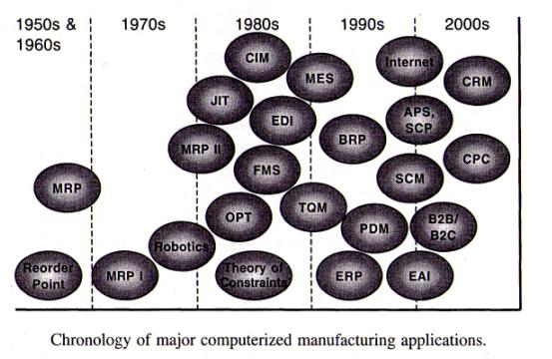
Cristian A Monzon - Six Sigma
Notes:
Cristian Alejandro Monzon - Logistica Inversa

Slide 3
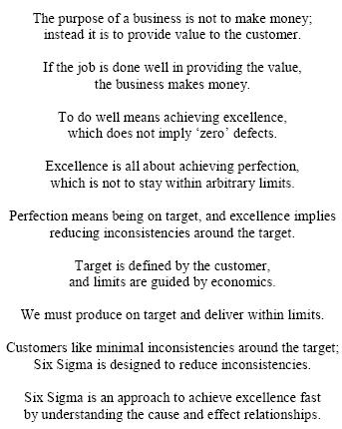
Cristian A Monzon - Six Sigma
Notes:
Cristian Alejandro Monzon - Logistica Inversa

Slide 4
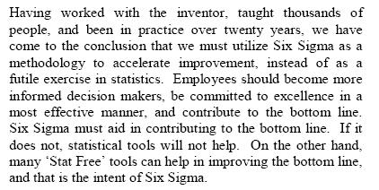
Cristian A Monzon - Six Sigma
Notes:
Cristian Alejandro Monzon - Logistica Inversa

Slide 5
Lean Six Sigma
Requires Behavioral Change
Lean Six Sigma Challenges Us to:
  Think Differently
  Work Differently
  Ask Questions and Challenge the Status Quo
  Make Decisions With Facts and Data
  Use New Principles, Tools and Methodologies
“Early-on, when culture and change compete, culture wins.”
        - Tom Quan, GlaxoSmithKline
Cristian A Monzon - Six Sigma

Slide 6
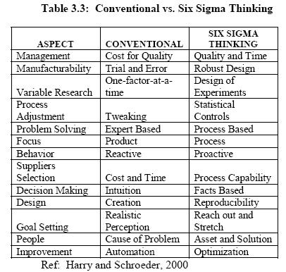
Lean Six Sigma
Requires Behavioral Change
Cristian A Monzon - Six Sigma

Slide 7
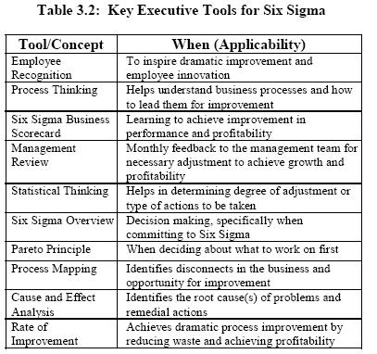
Lean Six Sigma
Requires Behavioral Change
Cristian A Monzon - Six Sigma

Slide 8
To Successfully Deploy
Lean Six Sigma
Start with the customer … listen, listen, listen
Leadership commitment and alignment … go beyond the words … change behavior
  Create momentum for change
  Develop need, vision and plan
  Communicate, communicate, communicate
  Repeatedly execute and assess
  Develop necessary skill sets to obtain the desired future state at all levels of the organization
Involve Everyone: Leadership, Champion, Master Black Belt, Black Belt, Green Belt, Employees
Cristian A Monzon - Six Sigma

Slide 9



Basic Questions
What are the customer needs?
Do our products or services
  answer the Voice of the Customer
  at a price he is willing to pay?
How do we know?
Cristian A Monzon - Six Sigma

Slide 10
Lean Six Sigma Principles
Specify value in the eyes of the customer
Identify the value stream and eliminate waste / variation
Make value flow smoothly at the pull of the customer
Involve, align and empower employees
Continuously improve knowledge in pursuit of perfection
Cristian A Monzon - Six Sigma

Slide 11
What is Six Sigma
Six Sigma is the measure of quality that strives for near perfection. It is a disciplined, data-driven methodology focused on eliminating defects. A Six Sigma defect is defined as anything that falls outside of a customer's specifications. Six Sigma is a reference to a statistical measuring system, equivalent to just 3.4 defects per every million opportunities (Snee, 2003).
Cristian A Monzon - Six Sigma
Notes:
Cristian Alejandro Monzon - Logistica Inversa

Slide 12
WHY SIX SIGMA
Intense competitive pressures – especially from rapid globalization.
Greater consumer demand for high quality products and services, little tolerance for failures of any type.
Top management (and stockholder) recognition of the high costs of poor quality.
The availability and accessibility of large data bases and the increasing ability to explore, understand, and use the data.
Cristian A Monzon - Six Sigma

Slide 13
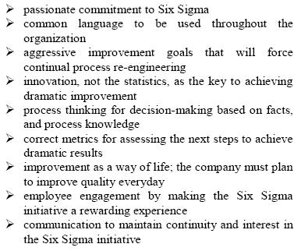
Success
Cristian A Monzon - Six Sigma

Slide 14
Sigma and % accuracy
Defects per Million % Accuracy Opportunities (DPMO)
One Sigma 691,500 30.85%
Two Sigma 308,500 69.15%
Three Sigma 66,810 93.32%
Four Sigma 6,210 99.38%
Five Sigma 233 99.977%
Six Sigma 3.4 99.9997%
Seven Sigma 0.020 99.999998%
Cristian A Monzon - Six Sigma

Slide 15
Inventor of Six Sigma
Motorola is known for its cool cell phones, but the company's more lasting contribution to the world is the quality-improvement process called Six Sigma. In 1986 an engineer named Bill Smith, sold then-Chief Executive Robert Galvin on a plan to strive for error-free products 99.9997% of the time. It is the origin of ‘Six Sigma’.
Cristian A Monzon - Six Sigma

Slide 16
Six Sigma at Motorola
Motorola saved $17 Billion from 1986 to 2004, reflecting hundreds of individual successes in all Motorola business areas including:
  Sales and Marketing
  Product design
  Manufacturing
  Customer service
  Transactional processes
  Supply chain management
Cristian A Monzon - Six Sigma

Slide 17
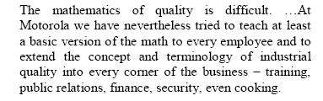
Six Sigma at Motorola
Cristian A Monzon - Six Sigma

Slide 18
General Electric: What Is Six Sigma?
“First, what it is not. It is not a secret society, a slogan, or a cliché. Six Sigma is a highly disciplined process that helps us focus on developing and delivering near-perfect products and services”
  Saved $750 million by the end of 1998
  Cut invoice defects and disputes by 98 percent, speeding payment, and creating better productivity
  Streamlined contract review process, leading to faster completion of deals and annual savings of $1 million
Cristian A Monzon - Six Sigma

Slide 19
Selecting the right projects for
SIX SIGMA
Assure that the importance of the projects is evident or can be readily demonstrated.
Assure the projects are viable and doable in a short time.
Assure that the success of the projects can be readily quantified.
Cristian A Monzon - Six Sigma

Slide 20
Six Sigma Team
Own vision, direction,
•
integration, results
Executive Leadership
•
Lead change
•
Project owner
•
Implement solutions
•
Part-time
•
Black Belt managers
•
Help Black Belts
Project Champions
Green Belts
Black Belts
Master Black
•
Full time
Belts
•
Train and coach
•
Devote 50% - 100% of time to Black Belt activities
Black and Green Belts
•
Facilitate and practice problem solving
•
Statistical problem solving experts
•
Train and coach Green Belts and project teams
Cristian A Monzon - Six Sigma

Slide 21

Levels of 6σ – Green Belt
Focuses on 1-2 projects, part time
Direction comes from Black Belt
Skilled at project management
Responsible for project progress
Leads planning teams’ work
Cristian A Monzon - Six Sigma

Slide 22

Levels of 6σ – Black Belt
Focuses on 1-3 projects, full time
Direction comes from Master Black Belt leadership
Candidate selection driven by projects
Cristian A Monzon - Six Sigma

Slide 23

Levels of 6σ – Master Black Belt
Full time project responsibility
Supports many improvement teams, not limited to a certain number of projects
Experience over different areas
Recruits and trains other Black Belts
Cristian A Monzon - Six Sigma

Slide 24
Levels of 6σ – Champion
Usually senior manager
Driving force behind organization’s 6σ implementation
Mentors to other Black Belts
Cristian A Monzon - Six Sigma

Slide 25
6σ Advancement Process
Green Belt
  Classroom + on the job training
  Complete a number of Six Sigma projects
  Receive support from Black Belts on site
Black Belt
  Same process as Green Belt, more intense
  Emerges as Six Sigma leader on site
Cristian A Monzon - Six Sigma

Slide 26
Six Sigma Methodology
(DMAIC)
Define
Measure
Control
Analyse
Improve
Cristian A Monzon - Six Sigma

Slide 27
DMAIC Steps
1. Define
1. Define
2. Measure
3. Analyze
4. Improve
5. Control
Identify projects that are measurable
Define projects including the demands of the customer and the content of the internal process.
Develop team charter
Define process map
Cristian A Monzon - Six Sigma

Slide 28
DMAIC Steps
2. Measure
5.0
Control
2. Measure
3. Analyze
4. Improve
5. Control
1. Define
Define performance standards
Measure current level of quality into Sigma. It precisely pinpoints the area causing problems.
Identify all potential causes for such problems.
Cristian A Monzon - Six Sigma

Slide 29
DMAIC Steps
3. Analyse
3. Analyse
4. Improve
5. Control
1. Define
2. Measure
Establish process capability
Define performance objectives
Identify variation sources
Tools for analysis
Process Mapping
Failure Mode & Effect Analysis
Statistical Tests
Design of Experiments
Control charts
Quality Function Deployment (QFD)
3.0
Analyze
Cristian A Monzon - Six Sigma

Slide 30
DMAIC Steps
4. Improve
4. Improve
5. Control
1. Define
2. Measure
3. Analyse
Screen potential causes and discover variable relationships among causes and effects
Establish operating tolerances
Pursue a method to resolve and ultimately eliminate problems. It is also a phase to explore the solution how to change, fix and modify the process.
Carryout a trial run for a planned period of time to ensure the revisions and improvements implemented in the process result in achieving the targeted values.
Cristian A Monzon - Six Sigma

Slide 31
DMAIC Steps
5. Control
1. Define
2. Measure
3. Analyse
4. Improve
5. Control
Monitor the improved process continuously to ensure long term sustainability of the new developments.
Share the lessons learnt
Document the results and accomplishments of all the improvement activities for future reference.
Cristian A Monzon - Six Sigma

Slide 32

Plan
Execute
Strategic Link to Business Plan defined in Project Selection Process
Defined Business Impact with Op Ex Champion support
Structured Brainstorming at all organizational levels
Cause and Effect Diagrams identifying critical factors
Primary and Secondary Metrics defined and charted
Multi-Level Pareto Charts to confirm project focus
Identify
Problem
DEFINE
Develop a focused Problem Statement and Objective
Develop a Process Map and/or FMEA
Develop a Current State Map
Identify the response variable(s) and how to measure them
Analyze measurement system capability
Assess the specification (Is one in place? Is it the right one?)
Practical Problem
MEASURE
Operational Excellence Methodology
Characterize the response, look at the raw data
  Abnormal? Other Clues? Mean or Variance problem?
Time Observation • Spaghetti Diagram • Takt Time
Future State Maps • Percent Loading
Standard Work Combination
Use Graphical Analysis, Multi-Vari, ANOVA and basic
statistical tools to identify the likely families of variability
Problem
Definition
ANALYZE
Practical Solutions
PERFECTION
Identify the likely X’s
5S • Set Up Time Reduction (SMED)
Material Replenishment Systems
Level Loading / Line Leveling
Cell Design • Visual Controls
Use Design of Experiments to find the critical few X’s
Move the distribution; Shrink the spread; Confirm the results
Problem
Solution
IMPROVE
Mistake Proof the process (Poka-Yoke)
Tolerance the process
Measure the final capability
Place appropriate process controls on the critical X’s
Document the effort and results
Standard Work • TPM
Problem Solving
Problem Control
CONTROL
What do you want to know?
How do you want to see what it is that you need
to know?
What type of tool will generate what it is that you
need to see?
What type of data is required of the selected tool?
Where can you get the required type of data?
Cristian A Monzon - Six Sigma
Execute
Plan
Based in part on Six Sigma Methodology developed by GE Medical Systems and Six Sigma Academy, Inc.
Crane Co. Op. Ex. Methodology Originated by MBBs; D. Braasch, J. Davis, R. Duggins, J. O’Callaghan, R. Underwood, I. Wilson
Notes:
Cristian Alejandro Monzon - Logistica Inversa

Slide 33
Conclusion
A gauge of quality and efficiency, Six Sigma is also a measure of excellence. Embarking on a Six Sigma program means delivering top-quality service and products while virtually eliminating all internal inefficiencies (Dedhia, 2005).
A true Six Sigma organization produces not only excellent product but also maintains highly efficient production and administrative systems that work effectively with the company's other service processes (Lucas, 2002).
The primary factor in the successful implementation of a six sigma project is to have the necessary resources, the support and leadership of top management.
Cristian A Monzon - Six Sigma

